Slide 1
Sorting
Bubble sort
Insertion sort
Selection Sort
Quick sort
Merge sort

Slide 2
Bubble sort
simplest sorting algorithm
repeatedly iterate through the array and swap adjacent elements that are unordered.
repeat this until the array is sorted.
Why bubble sort is called “bubble” sort?
because the elements with greater value than the adjacent element “bubble” towards the end.

Slide 3
Example---1
5 | 4 | 3 | 2 | 1
4 | 5 | 3 | 2 | 1
4 | 3 | 5 | 2 | 1
4 | 3 | 2 | 5 | 1
4 | 3 | 2 | 1 | 5
4 | 3 | 2 | 1
3 | 4 | 2 | 1
3 | 2 | 4 | 1
3 | 2 | 1 | 4
3 | 2 | 1
2 | 3 | 1
2 | 1 | 3
2 | 1
1 | 2

Slide 4
Psuedo code
void bubbleSort(int arr[], int n)
{
int i, j;
for (i = 0; i < n-1; i++)
// Last i elements are already in place
for (j = 0; j < n-i-1; j++)
if (arr[j] > arr[j+1])
swap(arr[j], arr[j+1]);
}

Slide 5
Example---1-----iteration----1
0 | 1 | 2 | 3 | 4 | I | J
5 | 4 | 3 | 2 | 1 | 0 | 0
4 | 5 | 3 | 2 | 1 | 0 | 1
4 | 3 | 5 | 2 | 1 | 0 | 2
4 | 3 | 2 | 5 | 1 | 0 | 3
4 | 3 | 2 | 1 | 5
N=5
i<n-1
j<n-1-I
i==0
J varies between 0 to 3
(arr[j] > arr[j+1])

Slide 6
Example---1-----iteration----2
0 | 1 | 2 | 3 | 4 | I | J
5 | 4 | 3 | 2 | 1 | 0 | 0
4 | 5 | 3 | 2 | 1 | 0 | 1
4 | 3 | 5 | 2 | 1 | 0 | 2
4 | 3 | 2 | 5 | 1 | 0 | 3
4 | 3 | 2 | 1 | 5
4 | 3 | 2 | 1 | 5 | 1 | 0
3 | 4 | 2 | 1 | 5 | 1 | 1
3 | 2 | 4 | 1 | 5 | 1 | 2
3 | 2 | 1 | 4 | 5
N=5
i<n-1
j<n-1-I
i==1
J varies between 0 to 2
(arr[j] > arr[j+1])

Slide 7
Example---1-----iteration----3
0 | 1 | 2 | 3 | 4 | I | J
5 | 4 | 3 | 2 | 1 | 0 | 0
4 | 5 | 3 | 2 | 1 | 0 | 1
4 | 3 | 5 | 2 | 1 | 0 | 2
4 | 3 | 2 | 5 | 1 | 0 | 3
4 | 3 | 2 | 1 | 5
4 | 3 | 2 | 1 | 5 | 1 | 0
3 | 4 | 2 | 1 | 5 | 1 | 1
3 | 2 | 4 | 1 | 5 | 1 | 2
3 | 2 | 1 | 4 | 5
3 | 2 | 1 | 4 | 5 | 2 | 0
2 | 3 | 1 | 4 | 5 | 2 | 1
2 | 1 | 3 | 4 | 5
N=5
i<n-1
j<n-1-I
i==2
J varies between 0 to 1
(arr[j] > arr[j+1])

Slide 8
Example---1-----iteration----4
0 | 1 | 2 | 3 | 4 | I | J
5 | 4 | 3 | 2 | 1 | 0 | 0
4 | 5 | 3 | 2 | 1 | 0 | 1
4 | 3 | 5 | 2 | 1 | 0 | 2
4 | 3 | 2 | 5 | 1 | 0 | 3
4 | 3 | 2 | 1 | 5
4 | 3 | 2 | 1 | 5 | 1 | 0
3 | 4 | 2 | 1 | 5 | 1 | 1
3 | 2 | 4 | 1 | 5 | 1 | 2
3 | 2 | 1 | 4 | 5
3 | 2 | 1 | 4 | 5 | 2 | 0
2 | 3 | 1 | 4 | 5 | 2 | 1
2 | 1 | 3 | 4 | 5
2 | 1 | 3 | 4 | 5 | 3 | 0
1 | 2 | 3 | 4 | 5 | 3
N=5
i<n-1
j<n-1-I
i==3
J varies between 0 to 1
(arr[j] > arr[j+1])

Slide 9
Characteristics of Bubble Sort:
Large values are always sorted first.
It only takes one iteration to detect that a collection is already sorted.
The best time complexity for Bubble Sort is O(n). The average and worst time complexity is O(n²).
The space complexity for Bubble Sort is O(1), because only single additional memory space is required.

Slide 10
Insertion sort
Insertion sort is a simple sorting algorithm that is appropriate for small inputs.
Most common sorting technique used by card players.
The list is divided into two parts: sorted and unsorted.
In each pass, the first element of the unsorted part is picked up, transferred to the sorted sublist, and inserted at the appropriate place.

Slide 11
Example
Initial
First iteration
23 | 1 | 10 | 5 | 2
23 | 1 | 10 | 5 | 2
1 | 23 | 10 | 5 | 2

Slide 12
Example
second iteration
Third iteration
1 | 10 | 23 | 5 | 2
1 | 23 | 10 | 5 | 2
1 | 5 | 10 | 23 | 2
1 | 10 | 23 | 5 | 2

Slide 13
Example
Fourth iteration
1 | 5 | 10 | 23 | 2
1 | 2 | 5 | 10 | 23

Slide 14
Algorithm
void insertionSort(int arr[], int n)
{
for (j = 1; j < n; i++)
{
key = arr[j];
i = j - 1;
//insert a[j] into the sorted sequence
while (i>=0) && arr[i] > key) do
{ arr[i + 1] = arr[i];
i=i-1;
}
arr[i + 1] = key;
}
}

Slide 15
N=5;;J<n
void insertionSort(int arr[], int n)
{
for (j = 1; j < n; i++)
{
key = arr[j];
i = j - 1;
//insert a[j] into the sorted sequence
while (i>=0) && arr[i] > key) do
{ arr[i + 1] = arr[i];
i=i-1;
}
arr[i + 1] = key;
}
}
0 | 1 | 2 | 3 | 4 | j | key | I
23 | 1 | 10 | 5 | 2 | 1 | 1 | 0
23 | 23 | 10 | 5 | 2 | 1 | 1 | -1
1 | 23 | 10 | 5 | 2 | 1 | 1 | -1

Slide 16
Example
N=5;;J<n
0 | 1 | 2 | 3 | 4 | j | key | I
23 | 1 | 10 | 5 | 2 | 1 | 1 | 0
23 | 23 | 10 | 5 | 2 | 1 | 1 | -1
1 | 23 | 10 | 5 | 2 | 1 | 1 | -1
1 | 23 | 23 | 5 | 2 | 2 | 10 | 1
1 | 10 | 23 | 5 | 2 | 2 | 10 | 0
1 | 10 | 23 | 23 | 2 | 3 | 5 | 2
1 | 10 | 10 | 23 | 2 | 3 | 5 | 1
1 | 5 | 10 | 23 | 2 | 3 | 5 | 0
1 | 5 | 10 | 23 | 23 | 4 | 2 | 3
1 | 5 | 10 | 10 | 23 | 4 | 2 | 2
1 | 5 | 5 | 10 | 23 | 4 | 2 | 1
1 | 2 | 5 | 10 | 23 | 4 | 2 | 0
void insertionSort(int arr[], int n)
{
for (j = 1; j < n; j++)
{
key = arr[j];
i = j - 1;
//insert a[j] into the sorted sequence
while (i>=0) && arr[i] > key) do
{ arr[i + 1] = arr[i];
i=i-1;
}
arr[i + 1] = key;
}
}

Slide 17
c1 | for (j = 1; j < n; j++) | n
c2 | key = arr[j]; | n-1
c3 | i = j - 1; | n-1
c4 | //insert a[j] into the sorte sequence | n-1
c5 | while (i>=0) && arr[i] > key) | (i=2 to n)∑t_{j}
c6 | arr[i + 1] = arr[i]; | (i=2 to n)∑t_{j}-1
c7 | i=i-1; | (i=2 to n)∑t_{j}-1
c8 | arr[i + 1] = key; | n-1

Slide 18
Characteristics of Insertion Sort:
It is efficient for smaller data sets, but very inefficient for the larger lists.
Insertion Sort is adaptive, that means it reduces its total number of steps if given a partially sorted list, hence it increases its efficiency.
Its space complexity is less. Insertion sort requires a single additional memory space.
Overall time complexity of Insertion sort is O(n²).

Slide 19
Insertion sort visualization
https://www.hackerearth.com/practice/algorithms/sorting/insertion-sort/visualize/

Slide 20
Selection sort
The selection sort algorithm sorts an array by repeatedly finding the minimum element (considering ascending order) from unsorted part and putting it at the beginning.
The algorithm maintains two subarrays in a given array.
1) The subarray which is already sorted.
2) Remaining subarray which is unsorted.
In every iteration of selection sort, the minimum element (considering ascending order) from the unsorted subarray is picked and moved to the sorted subarray.

Slide 21
Example
find the minimum element from a [0...4] and swap the a[0] with the min element
63 | 24 | 12 | 22 | 11
0 | 1 | 2 | 3 | 4
11 | 24 | 12 | 22 | 63
0 | 1 | 2 | 3 | 4

Slide 22
Example
find the minimum element from a [1...4] and swap the a[1] with the min element
11 | 24 | 12 | 22 | 63
0 | 1 | 2 | 3 | 4
11 | 12 | 24 | 22 | 63
0 | 1 | 2 | 3 | 4

Slide 23
Example
find the minimum element from a [2...4] and swap the a[2] with the min element
11 | 12 | 24 | 22 | 63
0 | 1 | 2 | 3 | 4
11 | 12 | 22 | 24 | 63
0 | 1 | 2 | 3 | 4

Slide 24
Example
find the minimum element from a [3...4] and swap the a[3] with the min element
11 | 12 | 22 | 24 | 63
0 | 1 | 2 | 3 | 4
11 | 12 | 22 | 24 | 63
0 | 1 | 2 | 3 | 4

Slide 25
Example
find the minimum element from a [3...4] and swap the a[4] with the min element
11 | 12 | 22 | 24 | 63
0 | 1 | 2 | 3 | 4
11 | 12 | 22 | 24 | 63
0 | 1 | 2 | 3 | 4

Slide 26
Pseudo code
void selectionSort(int arr[], int n)
{
int i, j, minidx;
// One by one move boundary of unsorted subarray
for (i = 0; i < n-1; i++)
{
// Find the minimum element in unsorted array
minidx = i;
for (j = i+1; j < n; j++)
if (arr[j] < arr[minidx])
minidx = j;
// Swap the found minimum element with the first element
swap(arr[minidx], arr[i]);
}
}

Slide 27
I iteration
void selectionSort(int arr[], int n)
{
int i, j, minidx;
// One by one move boundary of unsorted subarray
for (i = 0; i < n-1; i++)
{
// Find the minimum element in unsorted array
minidx = i;
for (j = i+1; j < n; j++)
if (arr[j] < arr[minidx])
minidx = j;
// Swap the found minimum element with the first element
swap(arr[minidx], arr[i]);
}
}
N=5;; i<n-1
0 | 1 | 2 | 3 | 4 | i | minidx | j
63 | 24 | 12 | 22 | 11 | 0 | 0 | 1
 |  |  |  |  | 0 | 1 | 2
 |  |  |  |  | 0 | 2 | 3
 |  |  |  |  |  | 4 | 4
11 | 24 | 12 | 22 | 63 |  | 4

Slide 28
II iteration
0 | 1 | 2 | 3 | 4 | i | minidx | j
63 | 24 | 12 | 22 | 11 | 0 | 0 | 1
 |  |  |  |  | 0 | 1 | 2
 |  |  |  |  | 0 | 2 | 3
 |  |  |  |  |  | 4 | 4
11 | 24 | 12 | 22 | 63 |  | 4
11 | 24 | 12 | 22 | 63 | 1 | 1 | 2
 |  |  |  |  |  | 2 | 3
 |  |  |  |  |  |  | 4
11 | 12 | 24 | 22 | 63
void selectionSort(int arr[], int n)
{
int i, j, minidx;
// One by one move boundary of unsorted subarray
for (i = 0; i < n-1; i++)
{
// Find the minimum element in unsorted array
minidx = i;
for (j = i+1; j < n; j++)
if (arr[j] < arr[minidx])
minidx = j;
// Swap the found minimum element with the first element
swap(arr[minidx], arr[i]);
}
}

Slide 29
III iteration
0 | 1 | 2 | 3 | 4 | i | minidx | j
63 | 24 | 12 | 22 | 11 | 0 | 0 | 1
 |  |  |  |  | 0 | 1 | 2
 |  |  |  |  | 0 | 2 | 3
 |  |  |  |  |  | 4 | 4
11 | 24 | 12 | 22 | 63 |  | 4
11 | 24 | 12 | 22 | 63 | 1 | 1 | 2
 |  |  |  |  |  | 2 | 3
 |  |  |  |  |  |  | 4
11 | 12 | 24 | 22 | 63 | 2 | 2 | 3
 |  |  |  |  |  | 3 | 4
11 | 12 | 22 | 24 | 63
void selectionSort(int arr[], int n)
{
int i, j, minidx;
// One by one move boundary of unsorted subarray
for (i = 0; i < n-1; i++)
{
// Find the minimum element in unsorted array
minidx = i;
for (j = i+1; j < n; j++)
if (arr[j] < arr[minidx])
minidx = j;
// Swap the found minimum element with the first element
swap(arr[minidx], arr[i]);
}
}

Slide 30
IV iteration
0 | 1 | 2 | 3 | 4 | i | minidx | j
63 | 24 | 12 | 22 | 11 | 0 | 0 | 1
 |  |  |  |  | 0 | 1 | 2
 |  |  |  |  | 0 | 2 | 3
 |  |  |  |  |  | 4 | 4
11 | 24 | 12 | 22 | 63 |  | 4
11 | 24 | 12 | 22 | 63 | 1 | 1 | 2
 |  |  |  |  |  | 2 | 3
 |  |  |  |  |  |  | 4
11 | 12 | 24 | 22 | 63 | 2 | 2 | 3
 |  |  |  |  |  | 3 | 4
11 | 12 | 22 | 24 | 63 | 3 | 4 | 4
 |  |  |  |  | 4
void selectionSort(int arr[], int n)
{
int i, j, minidx;
// One by one move boundary of unsorted subarray
for (i = 0; i < n-1; i++)
{
// Find the minimum element in unsorted array
minidx = i;
for (j = i+1; j < n; j++)
if (arr[j] < arr[minidx])
minidx = j;
// Swap the found minimum element with the first element
swap(arr[minidx], arr[i]);
}
}

Slide 31
Characteristics of Selection Sort:
It is efficient for smaller data sets, but very inefficient for the larger lists.
Selection Sort is efficient in average case which reduces the number of comparisons.
Its space complexity is less. selection sort requires a single additional memory space.
Overall time complexity of selection sort is O(n²).

Slide 32
Visualization effect
https://www.hackerearth.com/practice/algorithms/sorting/insertion-sort/visualize/

Slide 33
Quick sort
Quick sort is one of the most efficient sorting algorithms.
works on the principle of Divide and Conquer.
divide the problem into sub-problems
conquer the sub-problems
Efficient than Merge sort by using partitioning technique

Slide 34
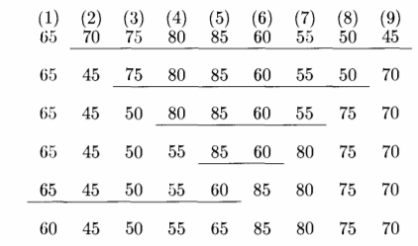
Partition technique
Example

Slide 35
Pseudo code
void quicksort(int a[25],int first, int last)
{
if(first<last){
pivot=first;
i=first;
j=last;
while(i<j)
{
while(a[i]<=a[pivot]&&i<last)
i++;
while(a[j]>a[pivot])
j--;
if(i<j)
{
temp=a[i];
a[i]=a[j];
a[j]=temp;
}
}
temp=a[pivot];
a[pivot]=a[j];
a[j]=temp;
quicksort(a,first,j-1);
quicksort(a,j+1,last);
}
}

Slide 36
Characteristics of Quick Sort
Quick Sort is useful for sorting arrays of any size.
Time complexity of Quick Sort is O(nLogn).
Space complexity of Quick Sort is O(nLogn).

Slide 37
MERGE sort
Merge sort is one of the most efficient sorting algorithms.
works on the principle of Divide and Conquer.
Merge sort repeatedly breaks down a list into several sublists until each sublist consists of a single element and merging those sublists in a manner that results into a sorted list.

Slide 38
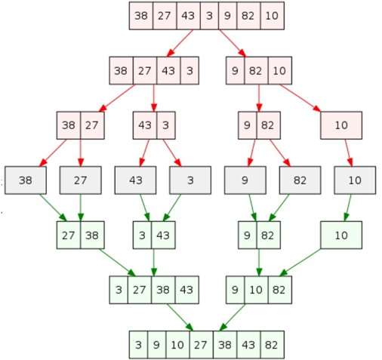
Example

Slide 39
merge the sorted array
5 | 6 | 7 | 8
1 | 2 | 3 | 4
1 | 2 | 3 | 4 | 5 | 6 | 7 | 8

Slide 40
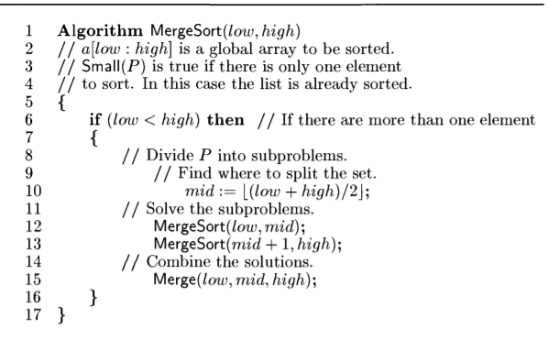
Psuedo code

Slide 41
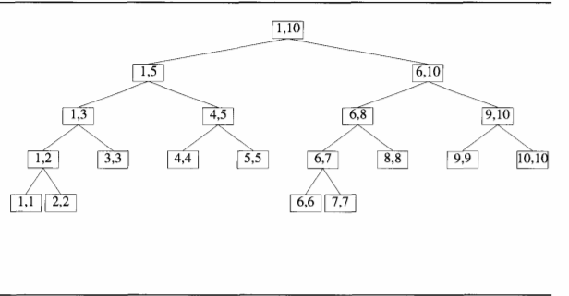
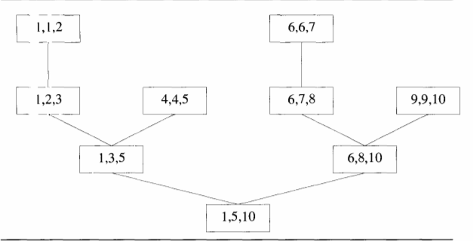
tree calls for mergesort(1,10)

Slide 42
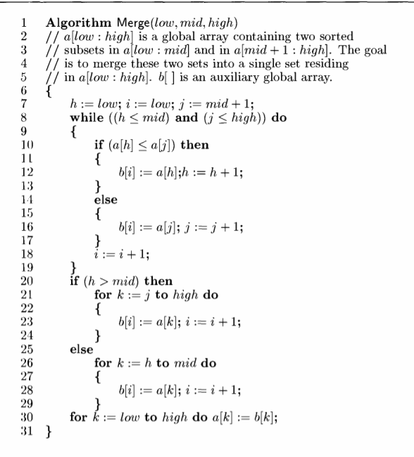
Psuedo code

Slide 43
5 | 6 | 7 | 8 | 1 | 2 | 3 | 4
0 | 1 | 2 | 3 | 4 | 5 | 6 | 7

Slide 44
Tree calls for Merge algorithm

Slide 45
Characteristics of merge sort
efficient
handle large volume of data
worst case analysis O(nlogn)
space complexity is high due to the usage of auxiliary array of same size

Slide 46
visualization
https://www.hackerearth.com/practice/algorithms/sorting/merge-sort/visualize/

Slide 47
Hashing
What is Hashing?
What is Hash Function? (k mod 10, k mod n, mid square method, etc)
What is Hash Table?
array , linked list, associative memory
key---24,52,91,67,48,83

Slide 48
Hashing
Hashing is the process of mapping large amount of data item to smaller table with the help of hashing function.
It is a technique to convert a range of key values into a range of indexes of an array.
Hashing allows to update and retrieve any data entry in a constant time O(1).
Hashing is used with a database to enable items to be retrieved more quickly.
It is used in the encryption and decryption of digital signatures.

Slide 49
In a hashed search, the key, through an algorithmic function, determines the location of the data. Because we are searching an array, we use a hashing algorithm to transform the key into the index that contains the data we need to locate.
Another way to describe hashing is as a key-to-address transformation in which the keys map to addresses in a list
Hashing is a key-to-address mapping process.

Slide 50
Hash Function
A fixed process converts a key to a hash key is known as a Hash Function.
This function takes a key and maps it to a value of a certain length which is called a Hash value or Hash.
Hash value represents the original string of characters, but it is normally smaller than the original.

Slide 51
Hash Table
Hash table or hash map is a data structure used to store key-value pairs.
Each key is mapped to a value in the hash table. The keys are used for indexing the values/data
It is a collection of items stored to make it easy to find them later.
It uses a hash function to compute an index into an array of buckets or slots from which the desired value can be found.
It is an array of list where each list is known as bucket.
It contains value based on the key.

Slide 52
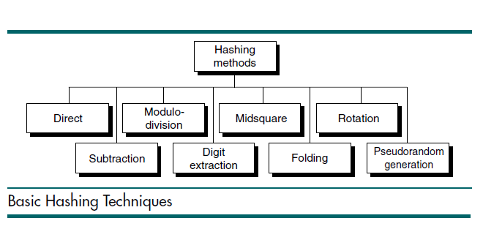

Slide 53
Direct addressing
Direct addressing is possible only when we can afford to allocate an array that has one position for every possible key.
every key has a unique array position, searching takes a constant time. O(1)

Slide 54
Modulo-division Hashing
address = key MODULO listSize

Slide 55
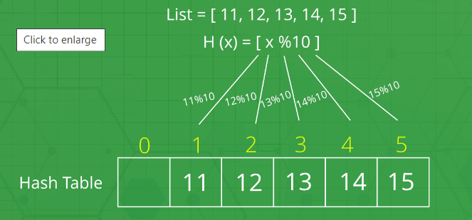
Modulo-division Hashing---example-1

Slide 56
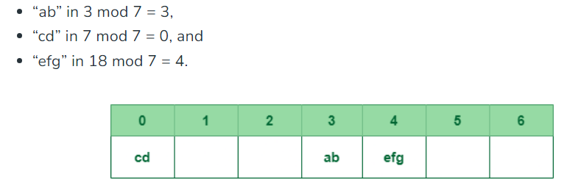
Example--2
set of strings {“ab”, “cd”, “efg”}
table of size 7
Assign numerical value to every character----here positional value is assigned
“ab” = 1 + 2 = 3,
“cd” = 3 + 4 = 7 ,
“efg” = 5 + 6 + 7 = 18

Slide 57
Digit-Extraction Method
Selected digits are extracted from the key and used as the address
379452 ➫ 394
121267 ➫ 112
378845 ➫ 388
160252 ➫ 102
045128 ➫ 051

Slide 58
Midsquare Method
The key is squared and the address is selected from the middle of the squared number
9452² = 89340304: address is 3403

Slide 59
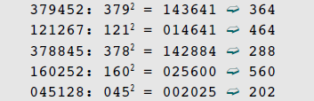
Variation on the midsquare
Select a portion of the key and then use them rather than the whole key.
Doing so allows the method to be used when the key is too large to
square

Slide 60
Folding Methods
Two folding methods are used
fold shift
fold boundary
In fold shift the key value is divided into parts whose size matches the size of the required address. Then the left and right parts are shifted and added with the middle part.

Slide 61
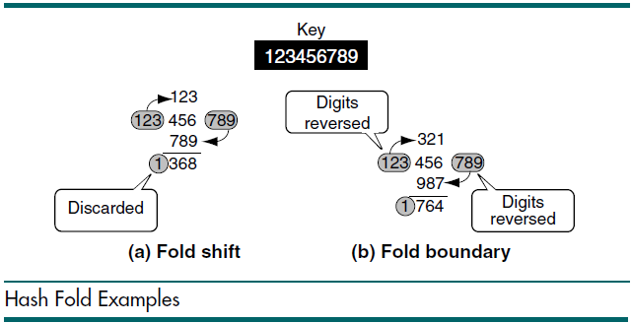

Slide 62
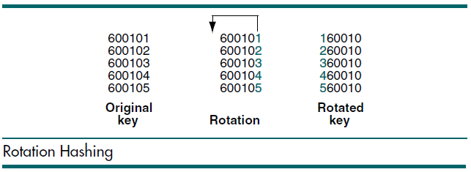
Rotation Method
Is incorporated in combination with other hashing methods

Slide 63
Pseudorandom Hashing
In pseudorandom hashing the key is used as the seed in a pseudorandom-number generator, and the resulting random number is then scaled into the possible address range using modulo-division
y = ax + c

Slide 64
Perfect Hash Function
A hash function that maps each item into a unique slot (no collisions).

Slide 65
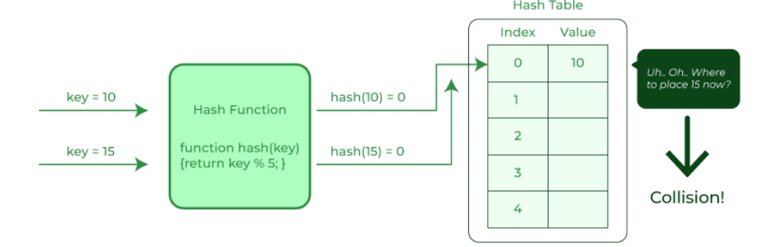
Collision
The hashing process generates a small number for a big key,
possibility that two keys could produce the same value.
situation where the newly inserted key maps to an already occupied, and it must be handled using collision handling technology.
When one or more hash values compete with a single hash table slot, collisions occur.
Solution
The next available empty slot is assigned to the current hash value

Slide 66
24, 19, 32, 44,58
k mod 6
identify collisions
0
1
2
3
4
5
24
19
32//44
58

Slide 67
Collision Resolution
Chaining ----(open hashing
Open addressing:---closed hashing
Linear Probe
Quadratic probe
Double hashing

Slide 68
chaining--open hashing
This technique implements a linked list and is the most popular collision resolution techniques
42, 19,10,12 ;; k mod 5
Maximum length of the chain, minimum length of the chain
10
0
1
2
3
4
42
12
19
Load factor(alpha)=total number of keys/ total number of slots
=4/5

Slide 69
Advantages---
easy insertion, deletion as per linked list operations
simple
disadvantages:::
more search time when the linked list is long--O(n)
uses extra space

Slide 70
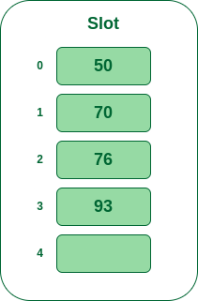
Linear probing
–the next probe interval is fixed to 1.
It supports best caching at cluster
consider a simple hash function as “key mod 5”
keys that are to be inserted are 50, 70, 76, 93.

Slide 71
keys, 43,135,72,23,99,19,82
linear probing
hash function k mod 10
19,#,72,43,23,135,82,#,#,99,
max probe---5 for key---82
search : O(n) as worst case ;else O(1)
Deletion:: suppose 43 deleted
Primary clustering
secondary clustering

Slide 72
Keys 1,3,12,4,25,6,18,20,8 are inserted into empty hash table of length 10 using open addressing with hash function i² mod 10 using linear probing. find the resultant hash table and find the maximum probe value.
20,1,8,#,12,25,4,6,18,3
MAximum probe--9for the key 8

Slide 73
Advantages of linear probing are as follows −
Linear probing requires very less memory.
It is less complex and is simpler to implement.
Disadvantages of linear probing are as follows −
Linear probing causes a scenario called "primary clustering" in which there are large blocks of occupied cells within the hash table.
The values in linear probing tend to cluster which makes the probe sequence longer and lengthier.

Slide 74
Quadratic probing
the probe distance is calculated based on the quadratic equation. This is considerably a better option as it balances clustering and caching.
H(K)=k mod 10
H’(K)= H(K)+i² mod 10
42,16,91,33,18,27,36,62
36 mod 10=6
6+1² mod 10=7
6+2² mod 10=0
62 mod 10=2
2+1² mod 10=3
2+2² mod 10=6
2+3² mod 10=1
2+4² mod 10=8
2+5² mod 10=7
2+6² mod 10=8
2+7² mod 10=1

Slide 75
The advantages of quadratic probing is as follows −
Quadratic probing is less likely to have the problem of primary clustering and is easier to implement than Double Hashing.
The disadvantages of quadratic probing are as follows −
Quadratic probing has secondary clustering. This occurs when 2 keys hash to the same location, they have the same probe sequence. So, it may take many attempts before an insertion is being made.
no guarantee to find a slot for keys

Slide 76
Double hashing
Double hashing uses a hash function of the form (h1(k) + i*h2(k))mod m where h1 and h2 are auxiliary hash functions and m is the size of the hash table.
h1(k)=k mod 11 h2(k)=8-(k mod 8) ; h1(k)+i.h2(k) mod 11
keys 20,34,45,70,56
56 mod 11=1, 8-(56 mod 8)=8, 1 +1.8 mod 11=9
1+2.8 mod 11=6
1+3.8 mod 11 =3
20 mod 11----9
34 mod 11--1
45 mod 11--1, 8-(45 mod 8)=8-5=3, 1+3 mod 11=4
70 mod 11--4, 8-(70 mod 8)=2, 4+2 mod 11=6
#, 34, #,56,45,#, 70,#,#,20,#

Slide 77
he advantage of double hashing is as follows −
no extra space
no primary clustering and secondary clustering
Double hashing finally overcomes the problems of the clustering issue.
The disadvantages of double hashing are as follows:
Double hashing is more difficult to implement than any other.

Slide 78
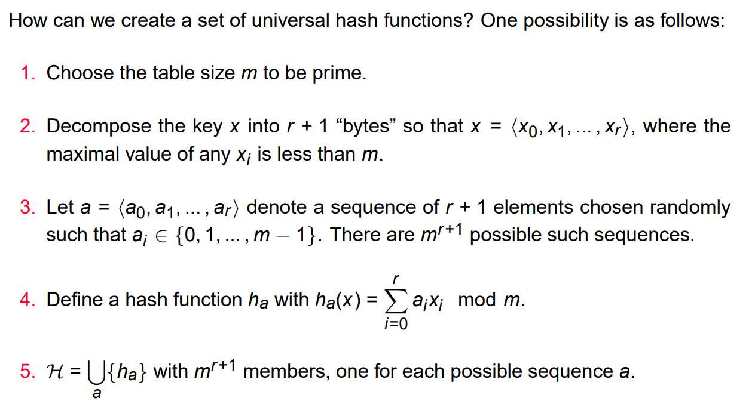
Theorem. If h is chosen from a universal class of hash functions and is used to hash n keys into a table of size m, where n ≤ m, the expected number of collisions involving a particular key x is less than 1.

Slide 79
Consider double hashing of the form
h(k,i)=(h 1 (k)+ih 2 (k)) mod m
Where h 1 (k)=k mod m
h 2 (k)=1+(k mod n)
Where n=m-1and m=701
for k=123456, what is the difference between first and second probes in terms of slots?
=> h(k, i) = (h1(k)+ih2 (k)) mod m => Where h​1​(k)=k mod m, h​2​ (k)=1+(k mod n) n=m-1, m=701 k = 123456
Now,
=> h1(k) = 123456 mod 701 = 80 => h2(k) = 1 + (123456 mod 700) = 1 + 256 = 257
1st probe: when i =1
=> h(k, i) = h1(k) + ih2(k) => h(k, 1) = h1(k) + h2(k) = 80 + 257 = 337
2nd probe: when i =2
=> h(k,2) = h1(k) + 2*h2(k) = 80 + 2*257
=> h(k,2) = 80 + 514 = 594
So, difference between first two probes = 594 – 337 = 257

Slide 80
Consider a hash table of size seven, with starting index zero, and a hash function (7x+3) mod 4. Assuming the hash table is initially empty, which of the following is the contents of the table when the sequence 1, 3, 8, 10 is inserted into the table using closed hashing ? Here “___” denotes an empty location in the table.
i ➥ 3, 10, 1, 8,__ ,____,___,
ii ➥ 1, 3, 8, 10,___,___,___.
iii ➥ 1,___,3,___, 8,,10
iv ➥ 3,10,___,___, 8,___,___.
option--1

Slide 81
The hash function used in double hashing is of the form:
i ➥ h (k, i) = (h1 (k) + h2 (k)
ii ➥ h (k, i) = ( h1(k) + h2 (k) – i) mod m
iii ➥ h (k, i) = ( h1(k) + i h2 (k)) mod m
iv ➥ h (k, i) = ( h1(k) – i h2 (k)) mod m
Option C

Slide 82
Consider the hash table of size 11 that uses open addressing with linear probing. Let h(k) = k mod 11 be the hash function. A sequence of records with keys 43, 36, 92, 87, 11, 47, 11, 13, 14 is inserted into an initially empty hash table. The bins of which are indexed from 0 to 10. What is the index of the bin into which the last record is inserted?
7

Slide 83
A hash function h defined h(key)=key mod 7, with linear probing, is used to insert the keys 44, 45, 79, 55, 91, 18, 63 into a table indexed from 0 to 6. What will be the location of key 18 ?
5

Slide 84
Linear Search/ Search Algorithm (sequential search)
LA - linear array with N elts; Algorithm to find an element with a value of ITEM, and return its position
1. Start
2. Set J = 0
3. Repeat steps 4 and 5 while J < N
4. IF LA[J] is equal ITEM THEN GOTO STEP 6
5. Set J = J +1
6. PRINT J, ITEM
7. Stop

Slide 85
The original array elements are : (searching for 5)
LA[0] = 1
LA[1] = 3
LA[2] = 5
LA[3] = 7
LA[4] = 8
Found element 5 at position 3

Slide 86
How many comparisons will happen in the following code (next slide) , for worst case, for an array of N elements?
Number of element comparisons----------n
Number of index comparisons-----n+1
Total comparisons-----2N+1

Slide 87
//linear search function
int linearSearch(int array[],int target, int size){
int position=0;
while(array[position]!=target){
if(position==size)
return -1;
else position++;}
return position; }
// code snippet of main()
int p=linearSearch(arr,t,s);
if (p==-1)
printf("%d is not in the array",t);
else printf("%d is found at %d position",t,p);

Slide 88
Sentinel Search:
Can we reduce the number of comparisons linear search
HOW???
//last element of the array is replaced with the element to be searched
//The number of comparisons in the worst case here will be
(N +2).
(N+2)<(2N+1)
SENTINEL SEARCH ANALYSIS
Number of element comparisons----------N+1 (as one element inserted)
Number of index comparisons-----1
Total comparisons-----N+2

Slide 89
// linear search
for (int i = 0; i < length; i++) {
if (array[i] == elementToSearch) {
return i;
}
}
return -1;
// sentinel search
i=0;
Array[n]=elementTosearch;
while (array[i] != elementToSearch) {
i++;
}
if( (i < N-1)
{
printf(" Item Found “);
}
else
{
printf( " Item Not Found“);
}

Slide 90
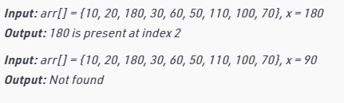
Example:

Slide 91
Binary Search

Slide 92
Binary Search:
//Searches a sorted array by repeatedly dividing the search interval in half
The process starts from the middle of the input array:
If the target = element in the middle, return its index.
Else If the target > element in the middle,
search the right half repeatedly.
Else search the left half repeatedly.

Slide 93
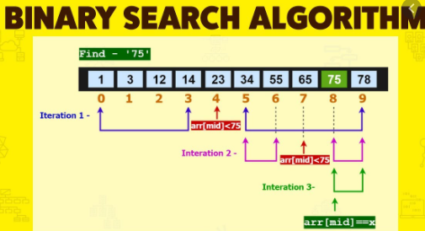

Slide 94
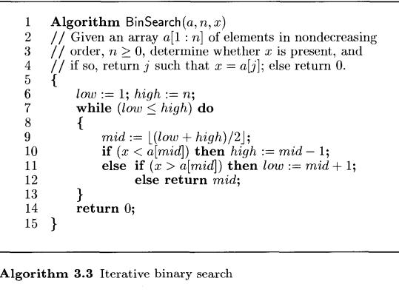
BinSearch(a,10,18)
Low | High | Mid | condition
1 | 10 | 5 | 1<=10
6 |  |  | 18<10, 18>10
 |  | 8 | 6<=10 18<16, 18>16
9 |  |  | 9<=10
 |  | 9 | 18<18, 18>18
1 | 2 | 3 | 4 | 5 | 6 | 7 | 8 | 9 | 10
2 | 4 | 6 | 8 | 10 | 12 | 14 | 16 | 18 | 20
X=18

Slide 95
Case | Time Complexity
Best Case | O(1)
Average Case | O(logn)
Worst Case | O(logn)

Slide 96
Linear search | Binary search
It follows a sequential approach. | This follows a divide and conquer approach.
It works well on unsorted data. | To apply binary search, data has to be sorted.
Its worst-case time complexity is O(n). | Its worst-case time complexity is O(log n)
It is slower in comparison to binary search. | It is more efficient than linear search.
In linear search, we compare an element with every other element. | In binary search, we don’t compare an element with all other elements. We leave a few comparisons.
We prefer linear search only for small-sized data. | It is preferred for large-sized data.
We can implement linear search on all linear data structures like arrays and linked lists. | We can implement binary search only on those data structures that permit 2-way traversal.

Slide 97
Key Operations for Abstract Strings
The concatenation of two strings
places a second string at the end of the first string;
The extraction of substrings,
Searching a string for a matching substring
determines if the given string is contained within the main string
Matching regular expressions
searching for patterns (starting / ending with “a” , does not contain “a”, etc.,)

Slide 98
String
It can be defined as a group characters which is terminated by a NULL
Each character of a string occupies one byte and last character of a string is always the character ‘\0’
\0 🡪 Null character and it stands for a character with a value of zero
String Functions
strcpy() strlwr()
strcat() strcmp()
strlen() strcmpi()
Strupr() strrev()
String.h

Slide 99
String ADT:
An Abstract Data Type (ADT) consists of a set of values, a defined set of properties of these values, and a set of operations for processing the values.
String ADT Values:
assumed to have information coded not only in the individual characters (alphabets, numbers and special characters) but also in the ordering of the characters. (meaningful names, eids, product codes etc)
Defined set of Properties
The component characters are from the ASCII character set
The characters are comparable
They have a length, from 0 to n

Slide 100
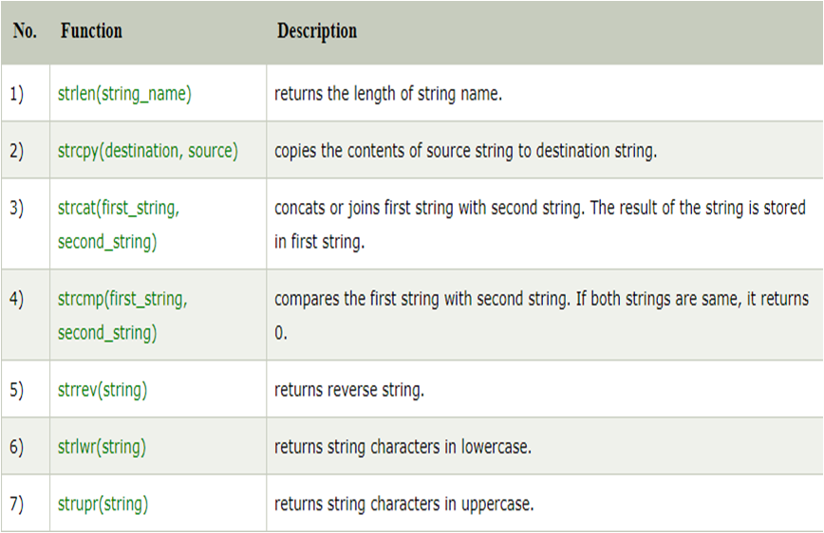

Slide 101
Strcpy() function :
It copies the contents of one string into another string.
Syntax : strcpy(string1,string2);
#include<stdio.h>
#include<string.h>
void main()
{
char str[25],cpy[25];
printf("\n Enter a String");
gets(str);
strcpy(cpy,str);
printf("\n The source string is %s",str);
printf("\n The copied string is %s",cpy);
}
OUTPUT
Enter a String : CSC
The Source string is : CSC
The Copied string is : CSC

Slide 102
Strcat() function :
it concatenates the source string at the end of the target string
Syntax : strcat(string1,string2);
#include<stdio.h>
#include<string.h>
void main()
{
char str[25],str1[25];
printf("\n Enter a String");
gets(str);
printf("\n Enter another String");
gets(str1);
printf("\n The concatenated string is %s",strcat(str,str1));
}
OUTPUT
Enter a String : CSC
Enter another String : COMPUTER
The Concatenated string is : CSC COMPUTER

Slide 103
Strcmp() function :
It compares two strings to find whether the strings are equal or not.
Syntax : strcmp(string1,string2);
#include<stdio.h>
#include<string.h>
void main()
{
char str[25],str1[25];
int x;
printf("\n Enter a String");
gets(str);
printf("\n Enter another String");
gets(str1);
x=strcmp(str,str1);
If(x==0)
printf(“\n Strings are equal”);
else if(x>0)
printf("\n The string1 %s is greater than string2 %s”,str,str1);
else
printf("\n The string2 %s is greater than string1 %s”,str1,str);
}
Enter a String : JAIKUMAR
Enter another String : SASIKUMAR
The string2 SASIKUMAR is greater than string1 JAIKUMAR
OUTPUT

Slide 104
Strcmpi() function :
It compares two strings without regard to case to find whether the strings are equal or not. ( i 🡪 ignorecase)
Syntax : strcmpi(string1,string2);
#include<stdio.h>
#include<string.h>
void main()
{
char str[25],str1[25];
int x;
printf("\n Enter a String");
gets(str);
printf("\n Enter another String");
gets(str1);
X=strcmpi(str,str1);
if(x==0)
printf(“\n The two Strings are equal”);
else if(x>0)
printf("\n The string1 %s is greater than string2 %s”,str,str1);
else
printf("\n The string2 %s is greater than string1 %s”,str1,str);
}
Enter a String : ABC
Enter another String : abc
The Two strings are equal
OUTPUT

Slide 105
strrev() function :
used to reverse a string. It takes only one argument.
Syntax : strrev(string);
#include<stdio.h>
#include<string.h>
void main()
{
char str[25];
printf("\n Enter a String");
gets(str);
printf("\n The Reversed string is %s",strrev(str));
}
OUTPUT
Enter a String : SHIVA
The reversed string is : AVIHS

Slide 106
strupr() function :
used to convert a string to uppercase. It takes only one argument.
Syntax : strupr(string);
#include<stdio.h>
#include<string.h>
void main()
{
char str[25];
printf("\n Enter a String");
gets(str);
printf("\n The case changed string is %s",strupr(str));
}
OUTPUT
Enter a String : csc
The case changed string is : CSC

Slide 107
strlwr() function :
used to convert a string to Lowercase. It takes only one argument.
Syntax : strlwr(string);
#include<stdio.h>
#include<string.h>
void main()
{
char str[25];
printf("\n Enter a String");
gets(str);
printf("\n The case changed string is %s",strlwr(str));
}
OUTPUT
Enter a String : CSC
The case changed string is : csc

Slide 108
strlen() function :
used to count the number of characters present in a string. It takes only one argument.
Syntax : int variablename=strlen(string);
#include<stdio.h>
#include<string.h>
void main()
{
char str[25];
printf("\n Enter a String");
gets(str);
printf("\n The length of the string is %d",strlen(str));
}
Enter a String : ABC
The length of the string is : 3

Slide 109
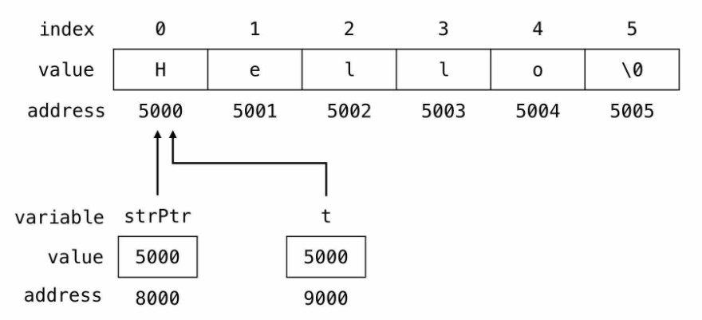
Strings and Pointers
#include <stdio.h>
main() {
// pointer variable to store string
char *strPtr = "Hello";
// temporary pointer variable
char *t = strPtr;
// print the string
while(*t != '\0') {
printf("%c", *t);
// move the t pointer to
//the next memory location
t++;
}
}

Slide 110
SUBSTRING
A substring is itself a string that is part of a longer string
str={“this is a test string”}
test
Substring

Slide 111
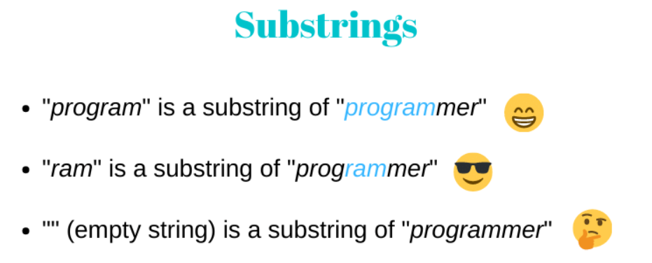
examples

Slide 112
operations on substring
extraction
//Extracts the mentioned number of characters from the given string
Inputs needed???
----
----
Index
//returns the position of the substring in the string

Slide 113
DEMO
SUBSTRING EXTRACTION
(starting position & Number of characters --length)
SUBSTRING EXTRACTION USING POINTERS
(starting position & ending position)

Slide 114
SUBSTRING FUNCTIONS IN <string.h>----index related operations in substring
strchr ( ) | Returns pointer to first occurrence of char in str1
strrchr ( ) | last occurrence of given character in a string is found
strstr ( ) | Returns pointer to first occurrence of str2 in str1
strncat() | concatenates n characters
strncpy() | copies n characters

Slide 115
strncpy
Description
The C library function char *strncpy(char *dest, const char *src, size_t n) copies up to n characters from the string pointed to, by src to dest. In a case where the length of src is less than that of n, the remainder of dest will be padded with null bytes.
Declaration
Following is the declaration for strncpy() function.
char *strncpy(char *dest, const char *src, size_t n)
Parameters
dest − This is the pointer to the destination array where the content is to be copied.
src − This is the string to be copied.
n − The number of characters to be copied from source.
Return Value
This function returns the final copy of the copied string.
demo----strncpy.c

Slide 116
strncat()
Description
The C library function char *strncat(char *dest, const char *src, size_t n) appends the string pointed to by src to the end of the string pointed to by dest up to n characters long.
Declaration
Following is the declaration for strncat() function.
char *strncat(char *dest, const char *src, size_t n)
Parameters
dest − This is pointer to the destination array, which should contain a C string, and should be large enough to contain the concatenated resulting string which includes the additional null-character.
src − This is the string to be appended.
n − This is the maximum number of characters to be appended.
Return Value
This function returns a pointer to the resulting string dest.
demo----strncat.c

Slide 117
strchr()
The function strchr() searches the occurrence of a specified character in the given string and returns the pointer to it.
char *strchr(const char *str, int ch)
str – The string in which the character is searched.
ch – The character that is searched in the string str.
Return Value of strchr()
It returns the pointer to the first occurrence of the character in the given string, which means that if we display the string value of the pointer then it should display the part of the input string starting from the first occurrence of the specified character.
demo----strchr.c

Slide 118
strrchr()
The strrchr() function searches the last occurrence of the specified character in the given string. This function works quite opposite to the function strchr() which searches the first occurrence of the character in the string.
char *strrchr(const char *str, int ch)
str – The string in which the character ch is searched.
ch – The character that needs to be searched
Return value of strrchr()
It returns the pointer to the last occurrence of the character in the string. Which means if we display the return value of the strrchr() then it should display the part of the string starting from the last occurrence of the specified character.
demo----strrchr.c

Slide 119
strstr()
The strstr() function searches the given string in the specified main string and returns the pointer to the first occurrence of the given string.
char *strstr(const char *str, const char *searchString)
str – The string to be searched.
searchString – The string that we need to search in string str
Return value of strstr()
This function returns the pointer to the first occurrence of the given string, which means if we print the return value of this function, it should display the part of the main string, starting from the given string till the end of main string.
demo----strstr.c

Slide 120
Drawbacks of strstr()
When the text and pattern are same, strstr will display only one index
Also, based on the requirements, pattern matching output cannot be customized in strstr
Efficiency can be improved by reducing the number of comparisons

Slide 121
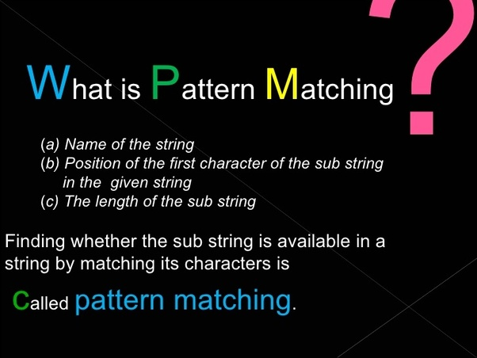
PATTERN MATCHING

Slide 122
APPLICATIONS
Compilation process to check the syntax
FIND & REPLACE
EMAIL VALIDATION
Plagiarism Detection
Spelling Checker
Search engines or content search in large databases

Slide 123
IMPLEMENTATION….
Regular programming languages make use of regular expressions
ALGORITHMS

Slide 124
Algorithms
Naive Pattern matching
KMP Algorithm
Rabin-Karp Algorithm
Finite Automata
Boyer Moore Algorithm

Slide 125
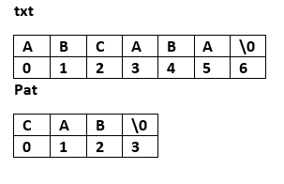
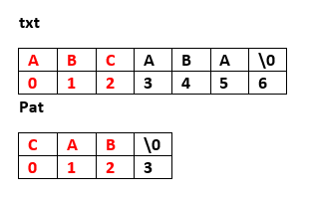
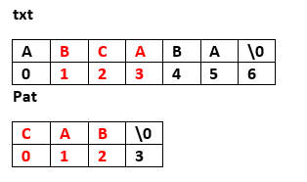
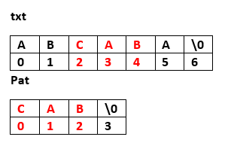
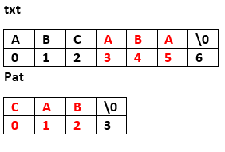
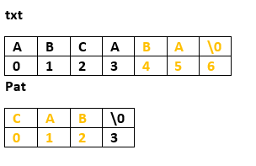
NAIVE PATTERN MATCHING

Slide 126
Characteristics
Number of iterations=n-m+1
Number of comparisons =m*(n-m+1)
Time Complexity==O(m*(n-m+1)

Slide 127
Improvements
Pattern length is greater than the string’
checking the first and/or last characters of pat and text before we compare the remaining characters

Slide 128
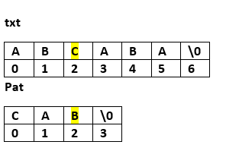
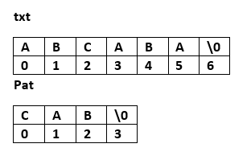
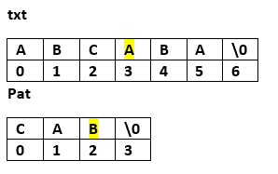
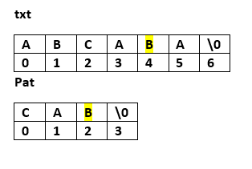
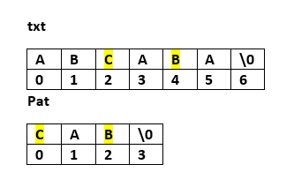
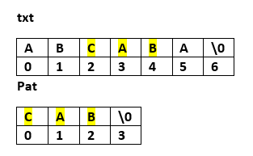
CHECKING THE LAST INDICES

Slide 129
PATTERN MATCHING (by checking the end indices first)
int nfind(char *string, char *pat)
{
// match the last character of the pattern first and then match from the beginning
int i,j,start=0;
int lasts=strlen(string)-1;
lastp=strlen(pat)-1;
int endmatch=lastp;
for(i=0;endmatch<=lasts;endmatch++,start++)
{
if string[endmatch]==pat[lastp])
for (j=0,i=start;j<lastp &&string[i]==pat[j];i++,j++)
;
if(j==lastp)
return start;
}
return-1;
}

Slide 130
DRAWBACKS OF NAIVE PATTERN MATCHING
Repeatedly checking the characters in the input string
No preprocessing is done for the pattern
BEST CASE
The best case occurs in the general –NAÏVE PATTERN matching algorithm is when the first character of the pattern is not present in text at all.
txt[] = "AABCCAADDEE";
pat[] = "FAA";

Slide 131
worst case
The worst case of Naive Pattern Searching occurs in following scenarios with maximum number of comparisons.
1) When all characters of the text and pattern are same.
txt[] = "AAAAAAAAAAAAAAAAAA";
pat[] = "AAAAA";
2) Worst case also occurs when only the last character is different.
txt[] = "AAAAAAAAAAAAAAAAAB";
pat[] = "AAAAB";

Slide 132
KMP algorithm
KNUTH --MORRIS--PRATT Algorithm
preprocessing is done for the pattern
Complexity is O(m+n)

Slide 133
failure function
void fail(char *pat)
{ // compute the pattern’s failure function
int n=strlen(pat);
failure[0]=-1;
for (j=1; j <n;j++)
i=failure[j-1];
while((pat[j]!=pat[i+1]) && i>==0)
i=failure[i];
if (pat[j]==pat[i+1])
failure[j]=i+1;
else
failure[j]=-1;
}
}

Slide 134
KMP algorithm
int pmatch(char *string, char * pat)
{ //Kunth,Morris, pratt algorithm
int i=0,j=0;
int lens=strlen(string);
int lenp=strlen(pat);
while(i<lens && j< lenp) {
if string[i]==pat[j]){
i++;j++;}
else if (j==0) i++;
else j=failure[j-1]+1;
}
return ((j==lenp) ?(i-lenp):-1);
}

